Slide 1

Team Void

Slide 2
Problem Statement : Small and marginal farmers rarely
receive timely, location-specific agricultural advice. Depending on
outdated or generic guidance leads to poor crop choices, inefficient
resource use, and avoidable yield losses.
AVS317
DIGITAL EMPOWERMENT FOR RURAL
COMMUNITIES.

Slide 3
Description : Farmers often struggle to decide which crops to grow and what fertilizers to use because they lack access to timely weather information, accurate soil data, and expert agricultural guidance. Traditional advisory systems are generic, not personalized, and do not consider the farmer’s real-time environment or soil conditions.
To solve this, there is a need for an intelligent, automated system that can combine real-time weather, farmer-specific soil attributes, and machine-learning models to provide personalized crop recommendations, fertilizer advice, and follow-up agricultural support through a simple conversational interface.

Slide 4
Solution
This project introduces an intelligent AI-driven Agricultural Assistant that provides personalized farming recommendations through a conversational interface. The system automatically gathers real-time environmental data using the farmer’s location and retrieves soil attributes from Firebase to ensure highly accurate inputs. It integrates machine learning models for crop and fertilizer prediction and uses Google Gemini’s tool-calling to make decisions dynamically and naturally within the conversation. The assistant guides farmers step-by-step—suggesting the best crop to grow, the right fertilizers to use, and offering follow-up advice on care, dosage, and cultivation practices. By combining weather intelligence, soil profiling, ML prediction, and natural language reasoning, the solution eliminates guesswork and delivers actionable, farmer-specific agricultural support in real time.

Slide 5
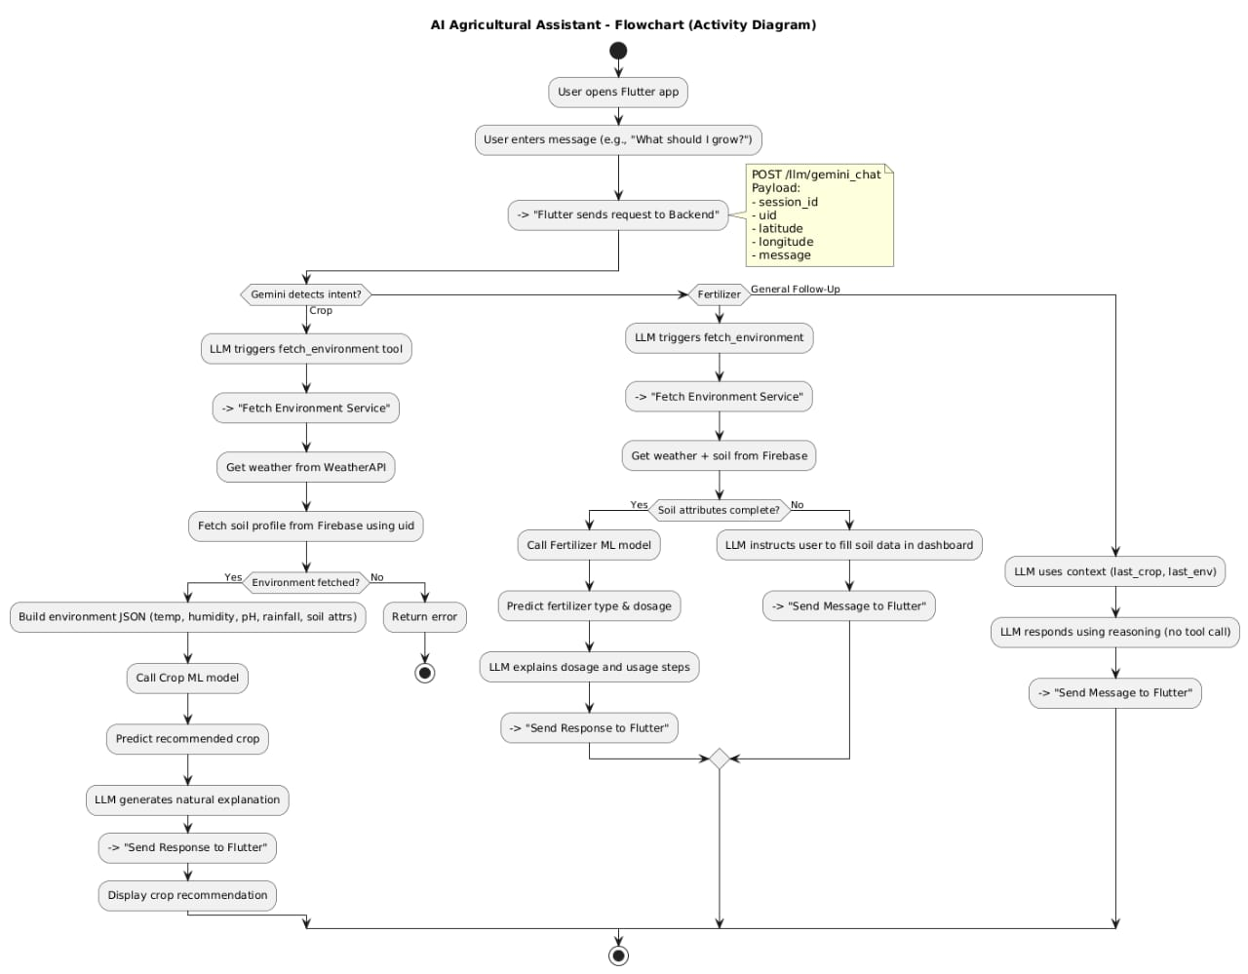

Slide 6
Tech Stack
🖥 Backend
FastAPI — High-performance backend framework for API and tool endpoints
Python 3.x — Core backend language
Joblib — Loading ML crop & fertilizer prediction models
Google Gemini 2.5 Flash — LLM with function-calling for intelligent chaining
HTTPX — Async HTTP client for internal tool calls
Pydantic — Request/response validation
🌦 Weather & Environment Services
WeatherAPI — Real-time temperature, humidity, rainfall
lru_cache — Improves performance for repeated weather fetches
🧪 Machine Learning
Crop Recommendation Model (crop_model.joblib)
Fertilizer Recommendation Model (fertilizer_model.joblib)
NumPy / Scikit-learn — Model training & preprocessing
Custom feature extraction pipelines

Slide 7
Tech Stack
🔗 AI + Tool Orchestration
Gemini Function Calling
fetch_environment
predict_crop
predict_fertilizer
Session Memory System
Tracks crop, environment, fertilizer status across chat
Context-aware intent detection
🔥 Cloud & Database
Firebase Firestore
Stores user soil profile (moisture, soil type, NPK, pH, crop type)
📱 Frontend (Flutter App)
Flutter 3.x — UI framework
Dart — Frontend programming language
Firebase Auth — User authentication
Geolocator — Location fetching for weather/environment

Slide 8
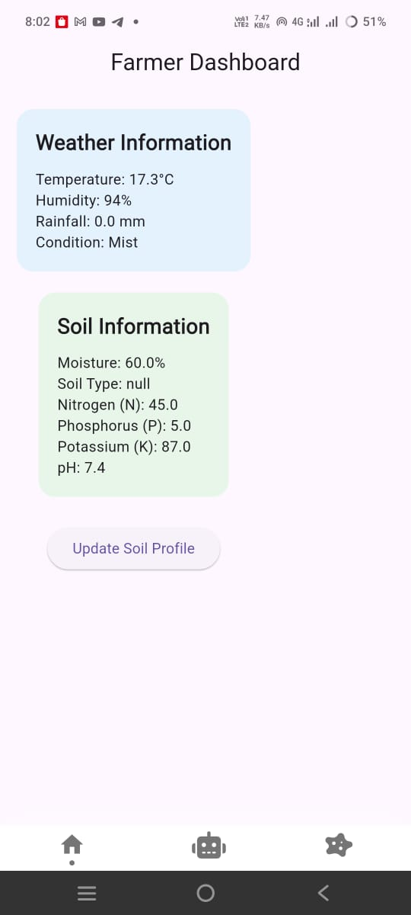
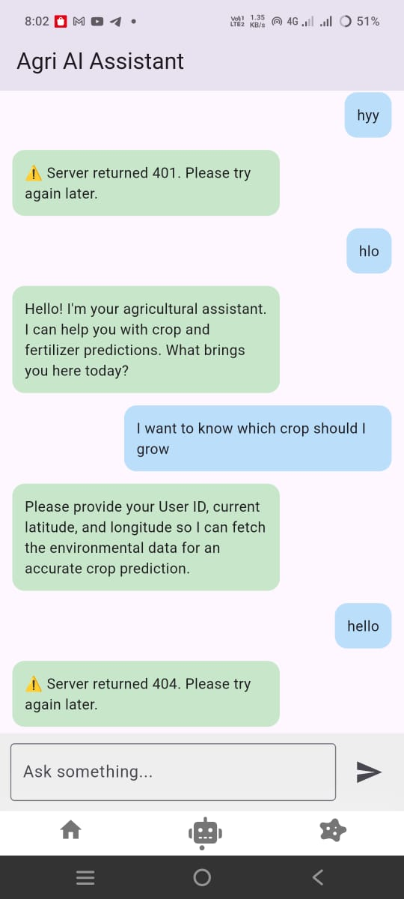
homepage/dashboard
ask llm page

Slide 9
Thank You

